Slide 1
SS ZG 526: Distributed Computing
Peer-to-Peer Networks continued …
Chittaranjan Hota
Professor, Dept. of Computer Sc. & Information Systems
BITS, Pilani Hyderabad Campus, Hyderabad
hota@hyderabad.bits-pilani.ac.in

Slide 2
DHT based P2P
A Distributed Hash Table (DHT) distributes data among a set of nodes according to some predefined rules. Each peer in a DHT-based network becomes responsible for a range of data items. To avoid the flooding overhead that we discussed for unstructured P2P networks, DHT-based networks allow each peer to have a partial knowledge about the whole network. This knowledge can be used to route the queries about the data items to the responsible nodes using effective and scalable procedures.
Birla Institute of Technology and Science, Pilani (Deemed University)

Slide 3
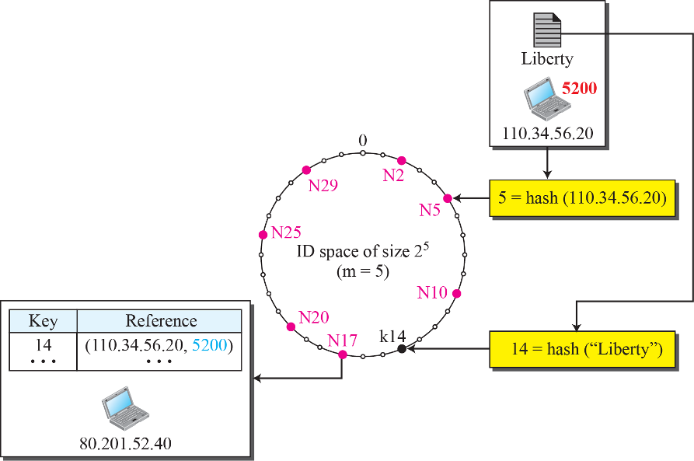
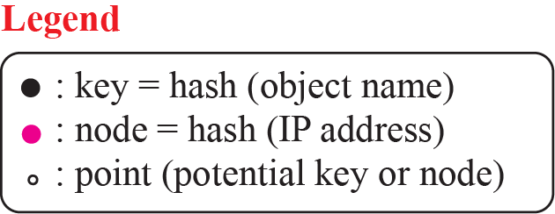

An Example
Source: MGH Co.

Slide 4

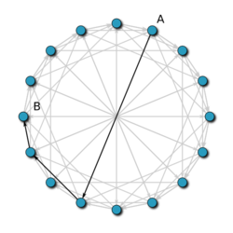
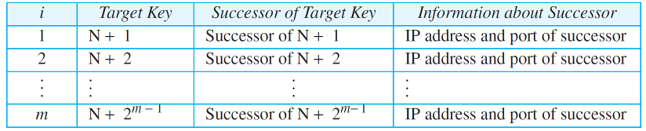
CHORD Finger table
Source: MGH Co.
Source: Wiki
https://pdos.csail.mit.edu/papers/chord:sigcomm01/chord_sigcomm.pdf
Birla Institute of Technology and Science, Pilani (Deemed University)

Slide 5

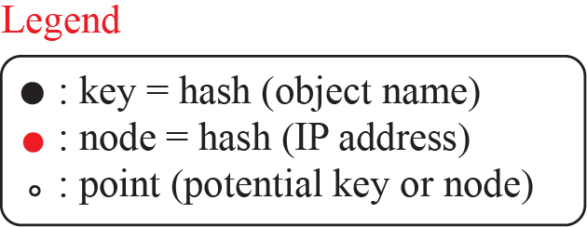

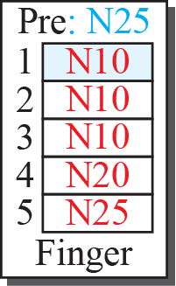
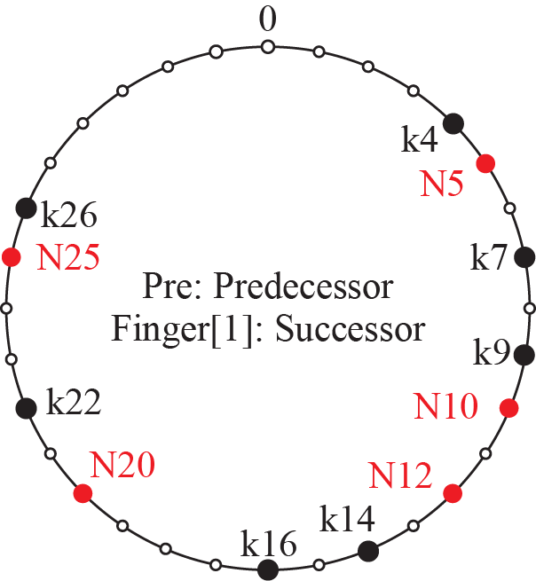
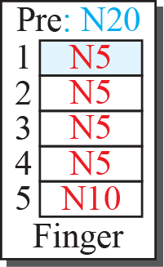


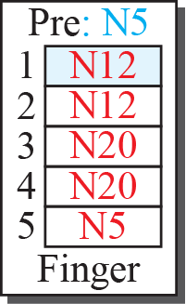


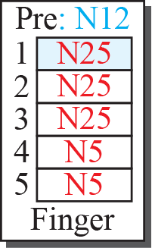
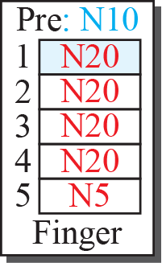
An example CHORD ring
Source: MGH Co.
Birla Institute of Technology and Science, Pilani (Deemed University)

Slide 6

Continued…
Key | node
9 | 32
10 | 32
12 | 32
16 | 32
33 | 60
40 | 60
“Where is key 80?”
N120
N08
N105
“N90 has K80”
N32
Finger table of N08
K80
N90
N60
Birla Institute of Technology and Science, Pilani (Deemed University)

Slide 7

Security concerns in P2P
Malicious attacks: nodes in a P2P system operate in an autonomous fashion, and any node that speaks the system protocol may participate in the system.
Solution: Mitigating attacks by nodes that abuse the P2P network by exploiting the implicit trust peers place on them.
Birla Institute of Technology and Science, Pilani (Deemed University)

Slide 8

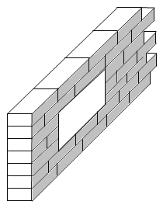


Security gap in P2P
Peer A
Peer B
Internet
Protected Network
A TCP Port
Peer X
Malicious Peer C
Firewall
Birla Institute of Technology and Science, Pilani (Deemed University)

Slide 9


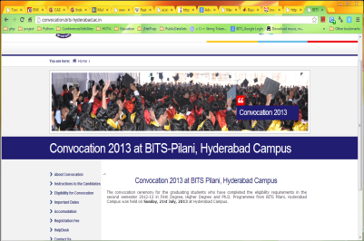
Denial of Service
GET /index.html HTTP/1.0
P1
3
A
QueryHit
“star”,” 192.168.100.220:80”
1
Query: “star”
192.168.100.220:80
(target)
P2
Query: “pop”
Query: “star”
QueryHit
“pop”, ” 192.168.100.220:80”
“star”,” 192.168.100.220:80”
Query: “pop”
Query: “star”
Malicious
Peer
192.168.100.40:4442
QueryHit: “star”,” 192.168.100.220:80”
QueryHit: “pop”, ” 192.168.100.220:80”
2
P3
Birla Institute of Technology and Science, Pilani (Deemed University)

Slide 10


File pollution attack
original content
polluted content
pollution
company

Slide 11


Continued…
pollution
server
pollution
company
File sharing
network
pollution
server
pollution
server
pollution
server
Birla Institute of Technology and Science, Pilani (Deemed University)

Slide 12


Continued…
Unsuspecting users
spread pollution!
Alice
File sharing
network
Bob
Birla Institute of Technology and Science, Pilani (Deemed University)

Slide 13

Index Poisoning
46.100.80.23
index
title location
file1 120.18.89.100
file2 46.100.80.23
file3 234.8.98.20
120.18.89.100
file sharing network
234.8.98.20
Birla Institute of Technology and Science, Pilani (Deemed University)

Slide 14


Continued…
46.100.80.23
index
title location
file1 120.18.89.100
file2 46.100.80.23
file3 234.8.98.20
file4 111.22.22.22
120.18.89.100
file sharing network
234.8.98.20
111.22.22.22
Birla Institute of Technology and Science, Pilani (Deemed University)

Slide 15


Fake block attack
Victim Peer
Genuine Blocks
5. Hash Fail
1. TCP Connection
Genuine Blocks
3. Block Request
2. Fake BitMap
4. Fake Block
Genuine Blocks
Attacker
Birla Institute of Technology and Science, Pilani (Deemed University)

Slide 16











Free riders
Tracker
Seeder
Free Rider
Birla Institute of Technology and Science, Pilani (Deemed University)

Slide 17







Sybil attack
Sybil
Victim
Birla Institute of Technology and Science, Pilani (Deemed University)

Slide 18
Next session
Security solutions for threats in P2P networks
Birla Institute of Technology and Science, Pilani (Deemed University)

